Slide 1

WSQ · PROCESS INTEGRATION
Mastering Semiconductor Key Modules for Enhanced CMOS Process Integration and Device Performance
Connect modules · control interactions · verify device performance
TGS-2024051248
Version v9.0 · 20 August 2026
Trainer: Dr Alfred Ang
Tertiary Infotech Academy Pte Ltd · UEN 201200696W

Slide 2
TRAQOM · SSG
Digital Attendance (Mandatory)
1
Take AM, PM and Assessment digital attendance for this WSQ course.
2
The trainer or administrator displays the SSG attendance QR code.
3
Scan with Singpass/mobile camera and submit each required attendance.
4
At least 75% attendance and a Competent outcome are required.
CMOS Process Integration · TGS-2024051248
© 2026 Tertiary Infotech Academy Pte Ltd
2

Slide 3
TRAINER PROFILE
About the Trainer - General Template
NAME
________________________________________
?
TITLE / DESIGNATION
________________________________________
QUALIFICATIONS
________________________________________
AREAS OF EXPERTISE
________________________________________
Your Trainer
Complete before delivery
TRAINING EXPERIENCE
________________________________________
CONTACT
________________________________________
CMOS Process Integration · TGS-2024051248
© 2026 Tertiary Infotech Academy Pte Ltd
3

Slide 4
TRAINER PROFILE
About the Trainer - Dr Alfred Ang
ROLE
Principal Trainer
AA
QUALIFICATIONS
Doctorate · ACTA/ACLP-aligned adult educator
EXPERTISE
Semiconductor · quality · emerging technology
Dr Alfred Ang
EXPERIENCE
Professional training and technology leadership
Principal Trainer
CONTACT
enquiry@tertiaryinfotech.com
CMOS Process Integration · TGS-2024051248
© 2026 Tertiary Infotech Academy Pte Ltd
4

Slide 5
ICEBREAKER
Let's Know Each Other
1
Name, organisation and role
2
Your semiconductor process or quality experience
3
One module interaction you find difficult
4
One result you want by the end of Day 2
CMOS Process Integration · TGS-2024051248
© 2026 Tertiary Infotech Academy Pte Ltd
5

Slide 6
HOUSEKEEPING
Ground Rules
1
Evidence first
2
Participate actively and ask technical questions
3
Respect confidential process and product information
4
One conversation at a time
distinguish measurements from assumptions
Participate actively and ask technical questions
Respect confidential process and product information
One conversation at a time
5
Return from breaks punctually
6
Stop any unsafe or unauthorised activity
Return from breaks punctually
Stop any unsafe or unauthorised activity
CMOS Process Integration · TGS-2024051248
© 2026 Tertiary Infotech Academy Pte Ltd
6

Slide 7
COURSE AT A GLANCE
Course Profile
Programme
Evidence and assessment
1
2 days · 16 hours
1
Official Topic 2: integration and performance
2
TSC: Process Integration
2
Eight individual activity folders
3
ELE-SIS-4002-1.1
3
WA-SAQ and Practical Performance
4
Official Topic 1: process flow
4
Open-book assessment on Day 2
CMOS Process Integration · TGS-2024051248
© 2026 Tertiary Infotech Academy Pte Ltd
7

Slide 8
WHAT YOU'LL ACHIEVE
Learning Outcomes
1
LO1
2
LO2
Identify process flows and modules for specific CMOS technologies in manufacturing.
Determine CMOS device performance and verify process integration in accordance with product specifications.
CMOS Process Integration · TGS-2024051248
© 2026 Tertiary Infotech Academy Pte Ltd
8

Slide 9
KNOWLEDGE K1-K2
Knowledge Coverage
1
K1
2
K2
Specific technology process flow
Types of performance metrics
CMOS Process Integration · TGS-2024051248
© 2026 Tertiary Infotech Academy Pte Ltd
9

Slide 10
ABILITIES A1-A5
Ability Coverage
1
A1
2
A2
3
A3
4
A4
Identify process flow for the specific technology in the manufacturing process in accordance with technology specifications
Determine process interaction between and within process modules to the specific technology in accordance with technology specifications
Determine device performance in accordance with product specifications
Verify process integration performance to the specific technology in accordance with product specifications
5
A5
Determine follow-up actions required
CMOS Process Integration · TGS-2024051248
© 2026 Tertiary Infotech Academy Pte Ltd
10

Slide 11
SCHEDULE
Lesson Plan - Day 1
Morning
Afternoon
1
09:00 Admin, outcomes and assessment briefing
1
13:15 Block 1B: implant, thermal and films
2
09:20 Block 1A: patterning and etch
2
15:05 Activities 3-4
3
10:40 Activities 1-2
3
17:20 Integrated-flow review
4
12:30 Lunch
4
18:00 End of Day 1
CMOS Process Integration · TGS-2024051248
© 2026 Tertiary Infotech Academy Pte Ltd
11

Slide 12
SCHEDULE
Lesson Plan - Day 2
Morning
Afternoon and assessment
1
09:00 Block 2A: performance, yield and reliability
1
14:15 Activities 7-8 and course synthesis
2
10:45 Activities 5-6
2
16:00 Written Assessment · 60 min
3
12:30 Lunch
3
17:00 Practical Performance · 60 min
4
13:15 Block 2B: SPC and packaging
4
18:00 End of class
CMOS Process Integration · TGS-2024051248
© 2026 Tertiary Infotech Academy Pte Ltd
12

Slide 13
BEFORE ASSESSMENT
Briefing for Assessment
1
Individual, open-book work; no discussion
2
Use only the slides, Learner Guide and approved materials
3
No photographs or recordings of assessment scripts
4
Submit on the LMS and sign the Assessment Summary Record
CMOS Process Integration · TGS-2024051248
© 2026 Tertiary Infotech Academy Pte Ltd
13

Slide 14
ASSESSMENT
Final Assessment
Knowledge
Ability
1
Written Assessment (WA-SAQ)
1
Practical Performance
2
2 open-ended questions
2
2 integrated tasks
3
K1-K2
3
A1-A5
4
60 minutes
4
60 minutes
CMOS Process Integration · TGS-2024051248
© 2026 Tertiary Infotech Academy Pte Ltd
14

Slide 15
ON ASSESSMENT DAY
Assessment Flow
1
2
3
4
5
▶
▶
▶
▶
TRAQOM on LMS
Assessment digital attendance
Sit WA then PP
Submit on LMS
Sign summary record
CMOS Process Integration · TGS-2024051248
© 2026 Tertiary Infotech Academy Pte Ltd
15

Slide 16
LEARNER MATERIALS
Access the Course Activities
Open the course repository to access all eight activity folders.
↗
Detailed download and file-access guidance is provided in the Learner Guide.
https://github.com/tertiarycourses/TGS-2024051248-Mastering-Semiconductor-Key-Modules-for-Enhanced-CMOS-Process-Integration-and-Device
CMOS Process Integration · TGS-2024051248
© 2026 Tertiary Infotech Academy Pte Ltd
16

Slide 17

COURSE PORTAL
Login to LMS and Download Course Material
Log in at lms-tms.tertiaryinfotech.com with your registered email and the OTP sent to your inbox, then open this course to download the slides and Learner Guide.
CMOS Process Integration · TGS-2024051248
© 2026 Tertiary Infotech Academy Pte Ltd
17

Slide 18
DOWNLOAD COURSE MATERIAL
Courseware and Assessment on the LMS
1
Download the current learner slides and Learner Guide
2
Use detailed procedures in the Learner Guide and activity folders
3
Complete the WA and PP in the scheduled assessment block
4
Upload completed answers on the LMS
CMOS Process Integration · TGS-2024051248
© 2026 Tertiary Infotech Academy Pte Ltd
18

Slide 19
PROCESS-INTEGRATION MINDSET
A fab is a connected system, not a collection of tools.
Every module hands variation, defects and evidence to the next module.
CMOS Process Integration · TGS-2024051248
© 2026 Tertiary Infotech Academy Pte Ltd
19

Slide 20
OFFICIAL TOPIC 1 · LEARNING BLOCK 1A
1A
Patterning, Etch and Fab Control
Build reliable patterns while controlling contamination, CD, overlay and profile.
CMOS Process Integration · TGS-2024051248
© 2026 Tertiary Infotech Academy Pte Ltd
20

Slide 21
PART 1 · BUILD THE MODEL
Block 1A Roadmap
1
The Wafer Fab as a System
2
Contamination Has Multiple Pathways
3
The Lithography Stack
4
Mask Tone and Resist Tone
The Wafer Fab as a System
Contamination Has Multiple Pathways
The Lithography Stack
Mask Tone and Resist Tone
5
Resist Coating and Bake
6
Resolution, NA and Process Margin
Resist Coating and Bake
Resolution, NA and Process Margin
CMOS Process Integration · TGS-2024051248
© 2026 Tertiary Infotech Academy Pte Ltd
21

Slide 22
PART 2 · VERIFY THE EVIDENCE
Block 1A Roadmap
1
Overlay, OPC and Mask Protection
2
Wet Etch versus Dry Etch
3
Etch Selectivity and Profile
4
Strip and Clean
Overlay, OPC and Mask Protection
Wet Etch versus Dry Etch
Etch Selectivity and Profile
Strip and Clean
5
Pattern-Transfer Window
6
Patterning Evidence Gate
Pattern-Transfer Window
Patterning Evidence Gate
CMOS Process Integration · TGS-2024051248
© 2026 Tertiary Infotech Academy Pte Ltd
22

Slide 23
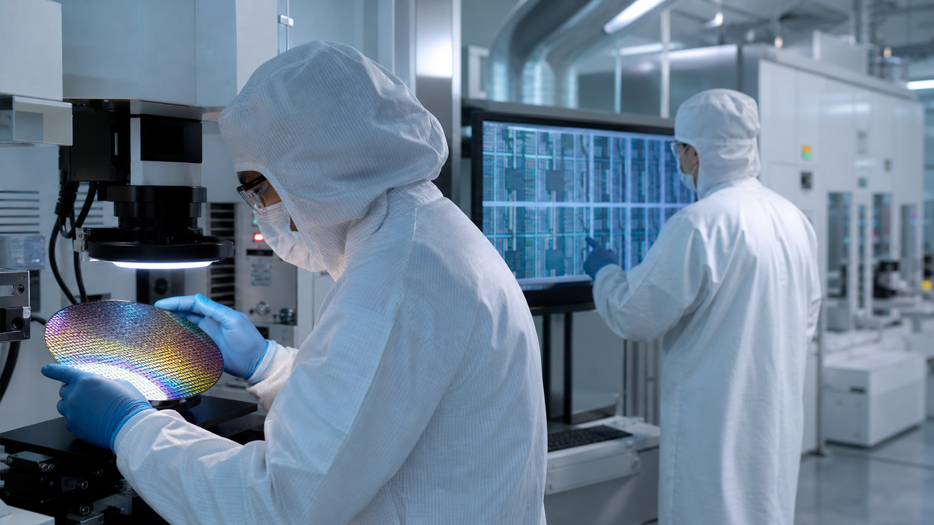
BLOCK 1A · IMAGEGEN VISUAL
Patterning, Etch and Fab Control in Practice
1
What module is creating the feature?
2
Which interaction can move device performance?
3
What measurement makes the decision defensible?
4
Where should feedback or containment occur?
CMOS Process Integration · TGS-2024051248
© 2026 Tertiary Infotech Academy Pte Ltd
23

Slide 24
LEARNING BLOCK 1A · OFFICIAL TOPIC 1
The Wafer Fab as a System
1
Product flow
2
Cleanroom
3
Integration
4
Release logic
hundreds of tightly coupled operations
particles and molecular contamination are controlled
each module owns incoming and outgoing evidence
a pass is a measured decision, not an assumption
CMOS Process Integration · TGS-2024051248
© 2026 Tertiary Infotech Academy Pte Ltd
24

Slide 25
LEARNING BLOCK 1A · OFFICIAL TOPIC 1
Contamination Has Multiple Pathways
1
Particles
2
Ions
3
Organics
4
Water and tools
block patterns and create opens or shorts
shift electrical behaviour and junction properties
interfere with adhesion, exposure and interfaces
transport hidden contamination between modules
CMOS Process Integration · TGS-2024051248
© 2026 Tertiary Infotech Academy Pte Ltd
25

Slide 26
LEARNING BLOCK 1A · OFFICIAL TOPIC 1
The Lithography Stack
WHAT CHANGES
WHAT TO VERIFY
1
Mask or reticle carries the intended geometry
1
Alignment connects the current level to prior levels
2
Resist converts optical energy into a soluble contrast
2
Developed resist becomes the etch or implant mask
CMOS Process Integration · TGS-2024051248
© 2026 Tertiary Infotech Academy Pte Ltd
26

Slide 27
LEARNING BLOCK 1A · OFFICIAL TOPIC 1
Mask Tone and Resist Tone
1
Clear-field and dark-field masks invert where light passes
2
Positive resist removes exposed regions
3
Negative resist retains exposed regions
4
The combination determines whether a hole or island remains
Clear-field and dark-field masks invert where light passes
Positive resist removes exposed regions
Negative resist retains exposed regions
The combination determines whether a hole or island remains
CMOS Process Integration · TGS-2024051248
© 2026 Tertiary Infotech Academy Pte Ltd
27

Slide 28
LEARNING BLOCK 1A · OFFICIAL TOPIC 1
Resist Coating and Bake
1
Prime improves adhesion on the prepared surface
2
Spin speed and dispense control resist thickness
3
Soft bake removes solvent without damaging image response
4
Edge bead and coverage affect focus and defectivity
Prime improves adhesion on the prepared surface
Spin speed and dispense control resist thickness
Soft bake removes solvent without damaging image response
Edge bead and coverage affect focus and defectivity
CMOS Process Integration · TGS-2024051248
© 2026 Tertiary Infotech Academy Pte Ltd
28

Slide 29
LEARNING BLOCK 1A · OFFICIAL TOPIC 1
Resolution, NA and Process Margin
Wavelength
Numerical aperture
Depth of focus
shorter light supports smaller features
higher NA improves resolution
normally shrinks as NA rises
CMOS Process Integration · TGS-2024051248
© 2026 Tertiary Infotech Academy Pte Ltd
29

Slide 30
LEARNING BLOCK 1A · OFFICIAL TOPIC 1
Overlay, OPC and Mask Protection
1
Overlay error shifts one layer against another
2
OPC pre-distorts features to counter imaging effects
3
Antireflective layers reduce standing-wave effects
4
Pellicles and inspection reduce repeating defects
Overlay error shifts one layer against another
OPC pre-distorts features to counter imaging effects
Antireflective layers reduce standing-wave effects
Pellicles and inspection reduce repeating defects
CMOS Process Integration · TGS-2024051248
© 2026 Tertiary Infotech Academy Pte Ltd
30

Slide 31
LEARNING BLOCK 1A · OFFICIAL TOPIC 1
Wet Etch versus Dry Etch
WHAT CHANGES
WHAT TO VERIFY
1
Wet etch is often isotropic and can undercut
1
Chemistry controls material reaction
2
Plasma/RIE supports directional profiles
2
Bias, pressure and transport influence sidewalls and damage
CMOS Process Integration · TGS-2024051248
© 2026 Tertiary Infotech Academy Pte Ltd
31

Slide 32
LEARNING BLOCK 1A · OFFICIAL TOPIC 1
Etch Selectivity and Profile
1
Selectivity protects resist and stop layers
2
Over-etch clears residual film but consumes margin
3
Microloading makes local pattern density matter
4
Endpoint and cross-section evidence localise failure
Selectivity protects resist and stop layers
Over-etch clears residual film but consumes margin
Microloading makes local pattern density matter
Endpoint and cross-section evidence localise failure
CMOS Process Integration · TGS-2024051248
© 2026 Tertiary Infotech Academy Pte Ltd
32

Slide 33
LEARNING BLOCK 1A · OFFICIAL TOPIC 1
Strip and Clean
1
Wet strip dissolves resist where surfaces tolerate chemistry
2
Dry strip removes organics but can damage sensitive layers
3
RCA-type cleans target particles, organics and metals
4
Drying must avoid watermarking and recontamination
Wet strip dissolves resist where surfaces tolerate chemistry
Dry strip removes organics but can damage sensitive layers
RCA-type cleans target particles, organics and metals
Drying must avoid watermarking and recontamination
CMOS Process Integration · TGS-2024051248
© 2026 Tertiary Infotech Academy Pte Ltd
33

Slide 34
LEARNING BLOCK 1A · OFFICIAL TOPIC 1
Pattern-Transfer Window
Lithography CD sets the incoming geometry
Etch bias changes the final feature
Across-wafer signatures expose non-uniformity
Lithography CD sets the incoming geometry
Etch bias changes the final feature
Across-wafer signatures expose non-uniformity
CMOS Process Integration · TGS-2024051248
© 2026 Tertiary Infotech Academy Pte Ltd
34

Slide 35
LEARNING BLOCK 1A · OFFICIAL TOPIC 1
Patterning Evidence Gate
1
Geometry
2
Defects
3
Mechanism
4
Action
CD, overlay and profile
bridge, open, pinhole, residue or collapse
exposure, develop, etch or clean
release, conditional release, hold or scrap
CMOS Process Integration · TGS-2024051248
© 2026 Tertiary Infotech Academy Pte Ltd
35

Slide 36
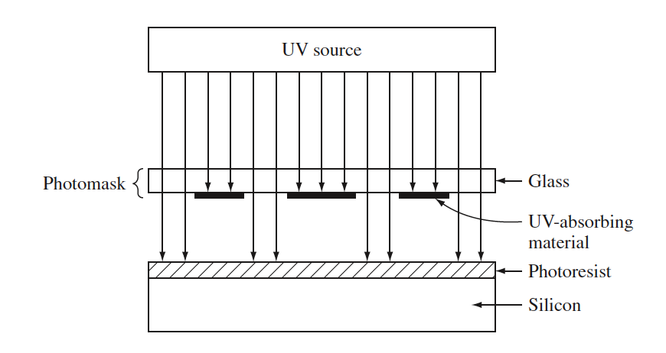
LEGACY VISUAL · SOURCE SLIDE 23
Photolithography Exposure Geometry
READ THE VISUAL
1
Trace light from source through the mask
2
Connect the aerial image to resist contrast
3
Identify the alignment reference
CMOS Process Integration · TGS-2024051248
© 2026 Tertiary Infotech Academy Pte Ltd
36

Slide 37
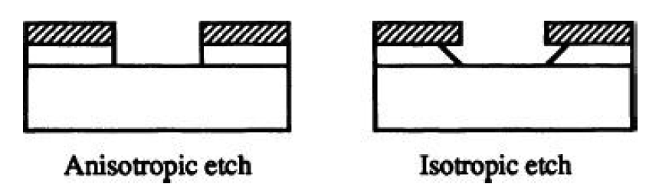
LEGACY VISUAL · SOURCE SLIDE 74
Etch Profile and Undercut
READ THE VISUAL
1
Compare anisotropic and isotropic profiles
2
Locate the material at risk during over-etch
3
Link sidewall shape to selectivity and transport
CMOS Process Integration · TGS-2024051248
© 2026 Tertiary Infotech Academy Pte Ltd
37

Slide 38
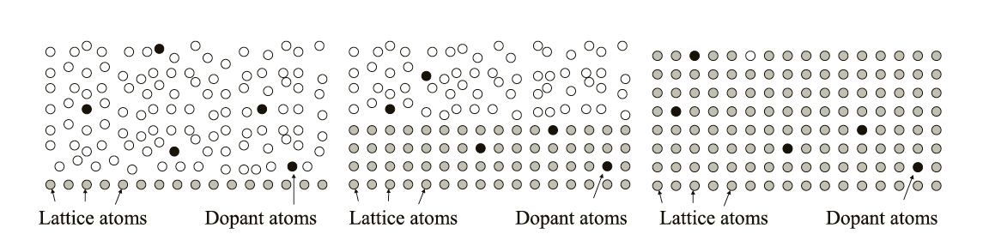
LEGACY VISUAL · SOURCE SLIDE 104
Damage Recovery and Dopant Activation
READ THE VISUAL
1
Separate crystal repair from electrical activation
2
Recognise diffusion during the thermal cycle
3
Relate the result to later junction performance
CMOS Process Integration · TGS-2024051248
© 2026 Tertiary Infotech Academy Pte Ltd
38

Slide 39
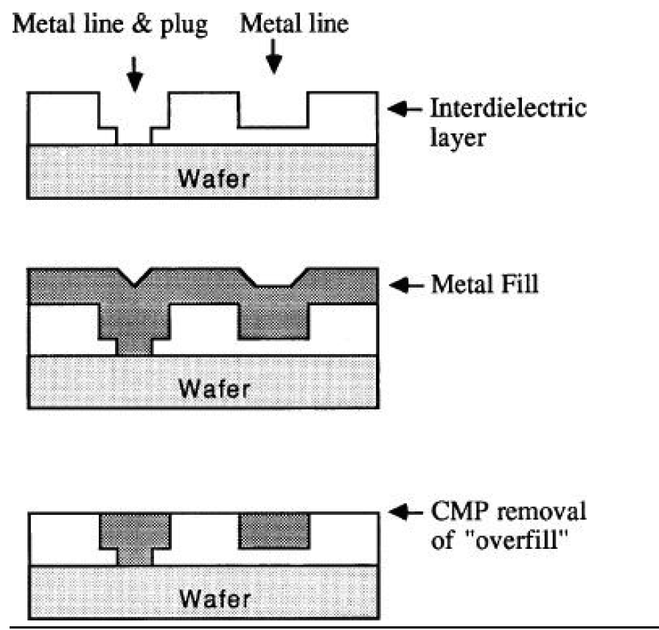
LEGACY VISUAL · SOURCE SLIDE 143
Dual-Damascene Integration
READ THE VISUAL
1
Follow via and trench formation
2
Locate barrier, seed and copper fill
3
Identify where CMP closes the module
CMOS Process Integration · TGS-2024051248
© 2026 Tertiary Infotech Academy Pte Ltd
39

Slide 40
LEARNING BLOCK 1A · REAL-USE-CASE ACTIVITY
Build a CMOS Process Module Map
ACTIVITY 1
A new 300 mm logic product is moving from process development into a pilot manufacturing line. The integration team needs one agreed process map before module owners set recipes and control plans.
YOU'LL PRODUCE
Organise the legacy module coverage into a defensible FEOL-to-BEOL flow and expose the interfaces that can propagate variation.
Full procedure: Learner Guide and individual activity folder
LO1 · K1 / A1 / A2 · 45 minutes
CMOS Process Integration · TGS-2024051248
© 2026 Tertiary Infotech Academy Pte Ltd
40

Slide 41
ACTIVITY 1 · ANALYSE BEFORE DECIDING
Visual Brief and Evidence Lens
1
Which module interaction is most critical?
2
What evidence distinguishes competing causes?
3
Where is the hold/release gate?
4
What follow-up action closes the risk?
CMOS Process Integration · TGS-2024051248
© 2026 Tertiary Infotech Academy Pte Ltd
41

Slide 42
ACTIVITY 1 · VERIFY
Acceptance Review
✓
The map contains all seven key process modules and distinguishes FEOL from BEOL.
✓
At least eight process hand-offs have a measurable characteristic.
✓
At least three control/feedback loops and two cross-module interactions are justified.
Evidence: analysis output · completed checklist · measurement trail · decision and owner
CMOS Process Integration · TGS-2024051248
© 2026 Tertiary Infotech Academy Pte Ltd
42

Slide 43
LEARNING BLOCK 1A · REAL-USE-CASE ACTIVITY
Diagnose a Pattern-Transfer Process Window
ACTIVITY 2
A contact layer shows intermittent bridging and open defects. Lithography CD, resist profile and plasma-etch selectivity must be reviewed together rather than as isolated module results.
YOU'LL PRODUCE
Connect mask/resist/exposure decisions to etch profile and select a stable corrective action without masking the root cause.
Full procedure: Learner Guide and individual activity folder
LO1 · K1 / A2 · 60 minutes
CMOS Process Integration · TGS-2024051248
© 2026 Tertiary Infotech Academy Pte Ltd
43

Slide 44
ACTIVITY 2 · ANALYSE BEFORE DECIDING
Visual Brief and Evidence Lens
1
Which module interaction is most critical?
2
What evidence distinguishes competing causes?
3
Where is the hold/release gate?
4
What follow-up action closes the risk?
CMOS Process Integration · TGS-2024051248
© 2026 Tertiary Infotech Academy Pte Ltd
44

Slide 45
ACTIVITY 2 · VERIFY
Acceptance Review
✓
Every defect is linked to a plausible lithography/etch mechanism.
✓
The dominant CD-shift stage is supported by before/after evidence.
✓
Corrective levers include predicted benefit, risk and verification measurement.
Evidence: analysis output · completed checklist · measurement trail · decision and owner
CMOS Process Integration · TGS-2024051248
© 2026 Tertiary Infotech Academy Pte Ltd
45

Slide 46
CHECK YOUR UNDERSTANDING
Block 1A Recap
1
Explain
2
Explain
3
Explain
4
Explain
Etch Selectivity and Profile
Strip and Clean
Pattern-Transfer Window
Patterning Evidence Gate
CMOS Process Integration · TGS-2024051248
© 2026 Tertiary Infotech Academy Pte Ltd
46

Slide 47
Lunch Break
45 minutes
CMOS Process Integration · TGS-2024051248
© 2026 Tertiary Infotech Academy Pte Ltd
47

Slide 48
OFFICIAL TOPIC 1 · LEARNING BLOCK 1B
1B
Implant, Thermal, Films and Integrated Flow
Control material modification, film formation, planarity and FEOL-to-BEOL hand-offs.
CMOS Process Integration · TGS-2024051248
© 2026 Tertiary Infotech Academy Pte Ltd
48

Slide 49
PART 1 · BUILD THE MODEL
Block 1B Roadmap
1
Implant Dose and Energy
2
Beamline Risks
3
Crystal Damage and Activation
4
Diffusion, Furnace and RTP
Implant Dose and Energy
Beamline Risks
Crystal Damage and Activation
Diffusion, Furnace and RTP
5
Thermal Oxidation
6
CVD, PECVD and Epitaxy
Thermal Oxidation
CVD, PECVD and Epitaxy
CMOS Process Integration · TGS-2024051248
© 2026 Tertiary Infotech Academy Pte Ltd
49

Slide 50
PART 2 · VERIFY THE EVIDENCE
Block 1B Roadmap
1
PVD, Barrier and Seed
2
Copper Dual Damascene
3
CMP Mechanics and Chemistry
4
Planarity Failure Modes
PVD, Barrier and Seed
Copper Dual Damascene
CMP Mechanics and Chemistry
Planarity Failure Modes
5
Integrated FEOL and BEOL
6
Cross-Module Budgeting
Integrated FEOL and BEOL
Cross-Module Budgeting
CMOS Process Integration · TGS-2024051248
© 2026 Tertiary Infotech Academy Pte Ltd
50

Slide 51
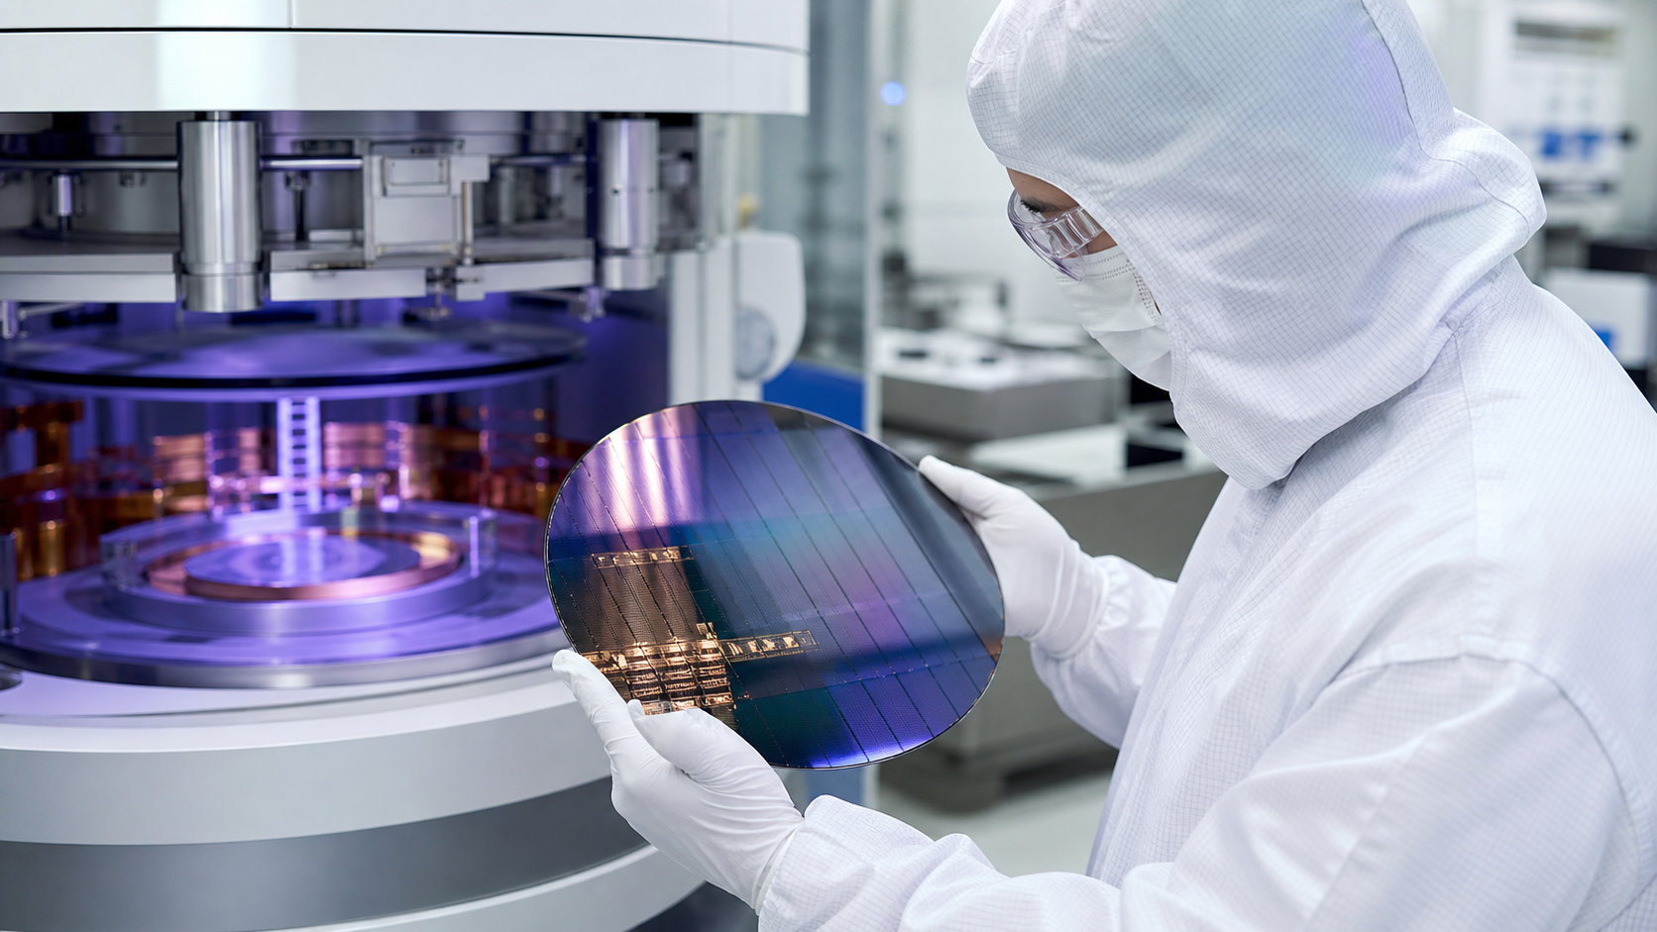
BLOCK 1B · IMAGEGEN VISUAL
Implant, Thermal, Films and Integrated Flow in Practice
1
What module is creating the feature?
2
Which interaction can move device performance?
3
What measurement makes the decision defensible?
4
Where should feedback or containment occur?
CMOS Process Integration · TGS-2024051248
© 2026 Tertiary Infotech Academy Pte Ltd
51

Slide 52
LEARNING BLOCK 1B · OFFICIAL TOPIC 1
Implant Dose and Energy
1
Dose controls total implanted ions
2
Energy controls the depth distribution
3
Tilt and twist reduce channeling and shadowing
4
Uniform scanning protects within-wafer consistency
Dose controls total implanted ions
Energy controls the depth distribution
Tilt and twist reduce channeling and shadowing
Uniform scanning protects within-wafer consistency
CMOS Process Integration · TGS-2024051248
© 2026 Tertiary Infotech Academy Pte Ltd
52

Slide 53
LEARNING BLOCK 1B · OFFICIAL TOPIC 1
Beamline Risks
1
Charging can deflect beams or damage dielectrics
2
Channeling produces unexpectedly deep tails
3
Mask topography creates shadowed regions
4
Beam focus and scan strategy affect uniformity
Charging can deflect beams or damage dielectrics
Channeling produces unexpectedly deep tails
Mask topography creates shadowed regions
Beam focus and scan strategy affect uniformity
CMOS Process Integration · TGS-2024051248
© 2026 Tertiary Infotech Academy Pte Ltd
53

Slide 54
LEARNING BLOCK 1B · OFFICIAL TOPIC 1
Crystal Damage and Activation
WHAT CHANGES
WHAT TO VERIFY
1
Implant collisions create vacancies and interstitials
1
Activation places dopants on useful sites
2
Anneal repairs lattice damage
2
Electrical improvement can coexist with diffusion
CMOS Process Integration · TGS-2024051248
© 2026 Tertiary Infotech Academy Pte Ltd
54

Slide 55
LEARNING BLOCK 1B · OFFICIAL TOPIC 1
Diffusion, Furnace and RTP
1
Furnace cycles favour batch throughput and long soak
2
RTP uses fast ramps and short dwell
3
Thermal budget controls activation and junction movement
4
The best cycle balances electrical target with geometry
Furnace cycles favour batch throughput and long soak
RTP uses fast ramps and short dwell
Thermal budget controls activation and junction movement
The best cycle balances electrical target with geometry
CMOS Process Integration · TGS-2024051248
© 2026 Tertiary Infotech Academy Pte Ltd
55

Slide 56
LEARNING BLOCK 1B · OFFICIAL TOPIC 1
Thermal Oxidation
1
Silicon is consumed as silicon dioxide grows
2
Dry oxidation grows slowly with strong film quality
3
Wet oxidation grows faster for thicker films
4
Temperature, time and surface condition control integrity
Silicon is consumed as silicon dioxide grows
Dry oxidation grows slowly with strong film quality
Wet oxidation grows faster for thicker films
Temperature, time and surface condition control integrity
CMOS Process Integration · TGS-2024051248
© 2026 Tertiary Infotech Academy Pte Ltd
56

Slide 57
LEARNING BLOCK 1B · OFFICIAL TOPIC 1
CVD, PECVD and Epitaxy
CVD
PECVD
Epitaxy
film forms through surface reactions
plasma lowers process temperature
deposited crystal follows the substrate lattice
CMOS Process Integration · TGS-2024051248
© 2026 Tertiary Infotech Academy Pte Ltd
57

Slide 58
LEARNING BLOCK 1B · OFFICIAL TOPIC 1
PVD, Barrier and Seed
1
Sputtering transports target atoms to the wafer
2
Directional coverage challenges deep features
3
Barrier films limit metal diffusion
4
Continuous seed enables uniform electrofill
Sputtering transports target atoms to the wafer
Directional coverage challenges deep features
Barrier films limit metal diffusion
Continuous seed enables uniform electrofill
CMOS Process Integration · TGS-2024051248
© 2026 Tertiary Infotech Academy Pte Ltd
58

Slide 59
LEARNING BLOCK 1B · OFFICIAL TOPIC 1
Copper Dual Damascene
WHAT CHANGES
WHAT TO VERIFY
1
Pattern vias and trenches in dielectric
1
Electrofill copper without seams or voids
2
Deposit liner, barrier and seed
2
Polish overburden while protecting pattern density
CMOS Process Integration · TGS-2024051248
© 2026 Tertiary Infotech Academy Pte Ltd
59

Slide 60
LEARNING BLOCK 1B · OFFICIAL TOPIC 1
CMP Mechanics and Chemistry
1
Pad contact and slurry chemistry work together
2
Downforce, speed and pad state affect removal
3
Selectivity protects stop layers
4
Post-CMP clean removes abrasive and metal residue
Pad contact and slurry chemistry work together
Downforce, speed and pad state affect removal
Selectivity protects stop layers
Post-CMP clean removes abrasive and metal residue
CMOS Process Integration · TGS-2024051248
© 2026 Tertiary Infotech Academy Pte Ltd
60

Slide 61
LEARNING BLOCK 1B · OFFICIAL TOPIC 1
Planarity Failure Modes
1
Dishing removes too much metal in wide features
2
Erosion lowers dense pattern regions
3
Incomplete clear leaves conductive residue
4
Topography and electrical continuity must both pass
Dishing removes too much metal in wide features
Erosion lowers dense pattern regions
Incomplete clear leaves conductive residue
Topography and electrical continuity must both pass
CMOS Process Integration · TGS-2024051248
© 2026 Tertiary Infotech Academy Pte Ltd
61

Slide 62
LEARNING BLOCK 1B · OFFICIAL TOPIC 1
Integrated FEOL and BEOL
Isolation and wells define device regions
Gate and source/drain form transistors
Contacts and interconnect create connectivity
Isolation and wells define device regions
Gate and source/drain form transistors
Contacts and interconnect create connectivity
CMOS Process Integration · TGS-2024051248
© 2026 Tertiary Infotech Academy Pte Ltd
62

Slide 63
LEARNING BLOCK 1B · OFFICIAL TOPIC 1
Cross-Module Budgeting
1
Thermal budget accumulates across later steps
2
Topography changes the next lithography window
3
Contamination transfers through surfaces and tools
4
Every hand-off needs evidence and an owner
Thermal budget accumulates across later steps
Topography changes the next lithography window
Contamination transfers through surfaces and tools
Every hand-off needs evidence and an owner
CMOS Process Integration · TGS-2024051248
© 2026 Tertiary Infotech Academy Pte Ltd
63

Slide 64
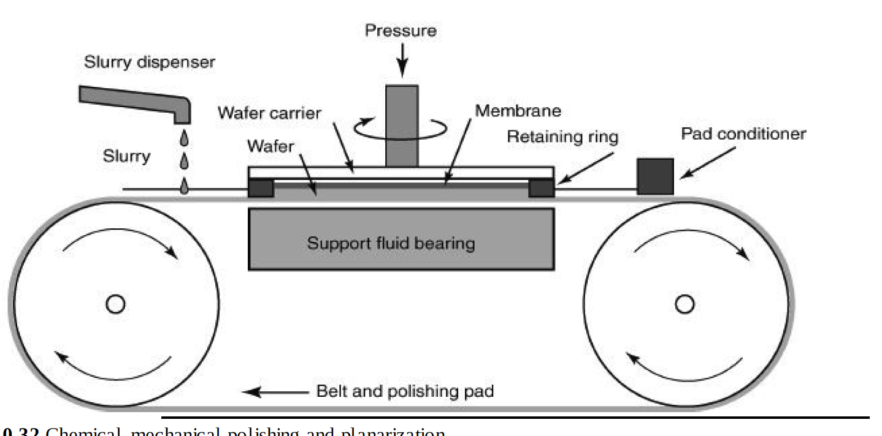
LEGACY VISUAL · SOURCE SLIDE 152
CMP Tool and Contact Mechanics
READ THE VISUAL
1
Locate wafer, pad and slurry interface
2
Connect relative motion to removal
3
Distinguish removal rate from final planarity
CMOS Process Integration · TGS-2024051248
© 2026 Tertiary Infotech Academy Pte Ltd
64

Slide 65
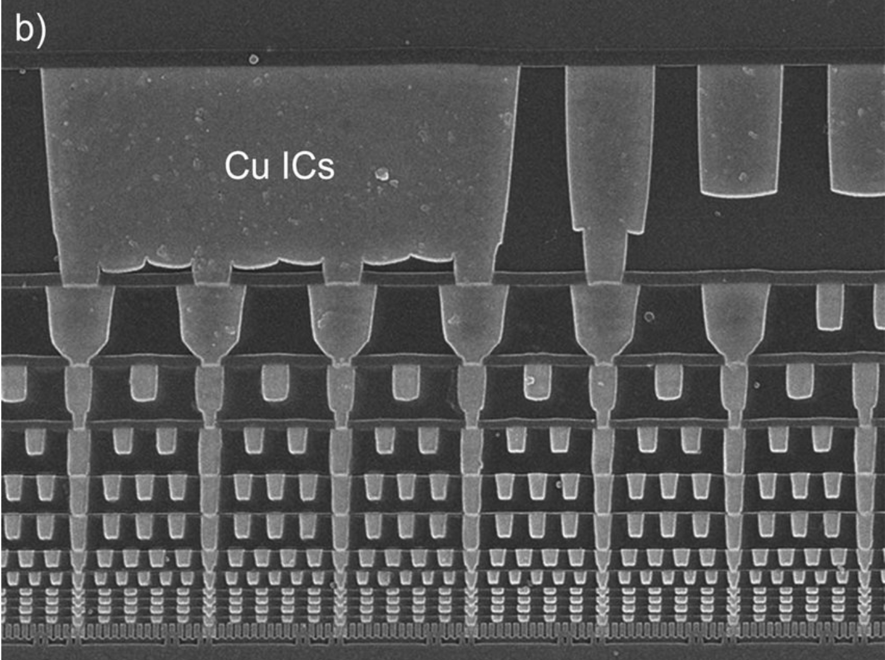
LEGACY VISUAL · SOURCE SLIDE 195
FEOL and BEOL Cross-Sections
READ THE VISUAL
1
Separate transistor formation from interconnect
2
Read connectivity through contacts and vias
3
Identify module interfaces
CMOS Process Integration · TGS-2024051248
© 2026 Tertiary Infotech Academy Pte Ltd
65

Slide 66
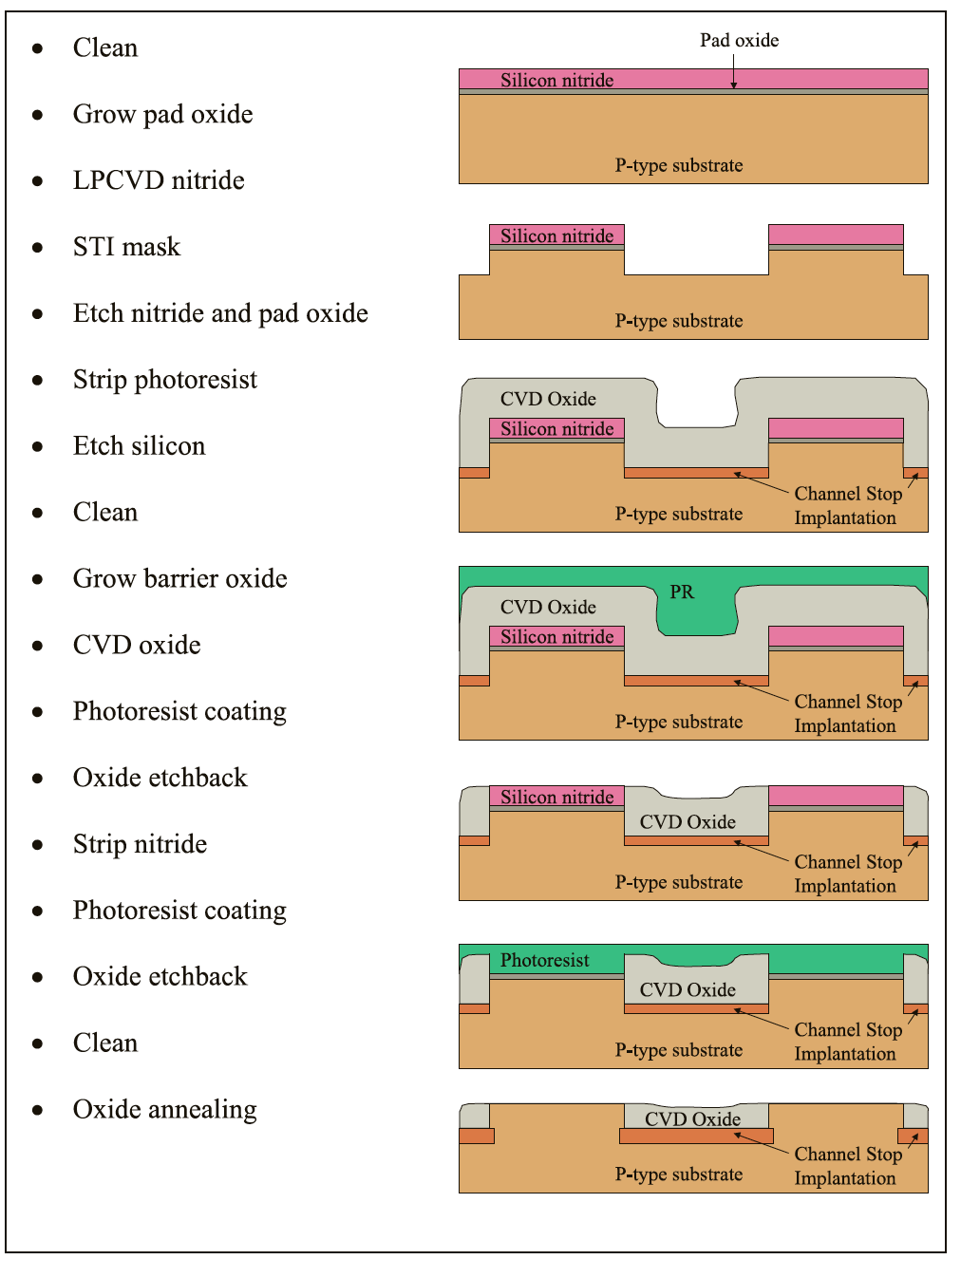
LEGACY VISUAL · SOURCE SLIDE 210
Shallow Trench Isolation Flow
READ THE VISUAL
1
Follow trench from pattern to fill
2
Locate etch, oxidation, deposition and CMP
3
Identify where active-area CD can move
CMOS Process Integration · TGS-2024051248
© 2026 Tertiary Infotech Academy Pte Ltd
66

Slide 67
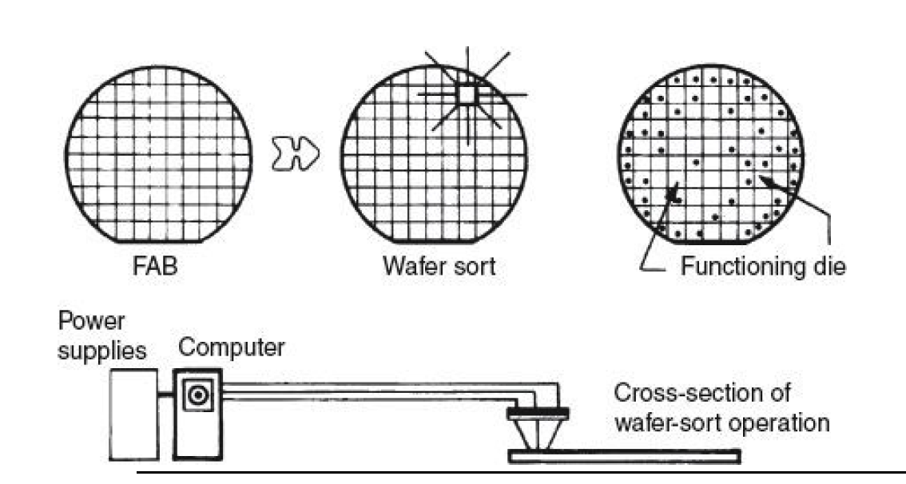
LEGACY VISUAL · SOURCE SLIDE 219
Wafer Sort as an Integration Gate
READ THE VISUAL
1
Test every die against criteria
2
Convert results into wafer-level patterns
3
Feed spatial signatures back to modules
CMOS Process Integration · TGS-2024051248
© 2026 Tertiary Infotech Academy Pte Ltd
67

Slide 68
LEARNING BLOCK 1B · REAL-USE-CASE ACTIVITY
Balance Implantation and Thermal Budget
ACTIVITY 3
After a source/drain extension implant, sheet resistance is above target and short-channel control is drifting. The team must distinguish dose/energy error from activation and diffusion effects.
YOU'LL PRODUCE
Create an implant-to-anneal decision trail that balances activation, junction depth, damage recovery and channeling risk.
Full procedure: Learner Guide and individual activity folder
LO1 · K1 / A2 / A3 · 60 minutes
CMOS Process Integration · TGS-2024051248
© 2026 Tertiary Infotech Academy Pte Ltd
68

Slide 69
ACTIVITY 3 · ANALYSE BEFORE DECIDING
Visual Brief and Evidence Lens
1
Which module interaction is most critical?
2
What evidence distinguishes competing causes?
3
Where is the hold/release gate?
4
What follow-up action closes the risk?
CMOS Process Integration · TGS-2024051248
© 2026 Tertiary Infotech Academy Pte Ltd
69

Slide 70
ACTIVITY 3 · VERIFY
Acceptance Review
✓
The recommendation distinguishes implant dose/energy, damage and activation mechanisms.
✓
Thermal-budget effects on activation and diffusion are explicit.
✓
Follow-up measurements can confirm or reject the proposed cause.
Evidence: analysis output · completed checklist · measurement trail · decision and owner
CMOS Process Integration · TGS-2024051248
© 2026 Tertiary Infotech Academy Pte Ltd
70

Slide 71
LEARNING BLOCK 1B · REAL-USE-CASE ACTIVITY
Integrate Film Deposition and CMP
ACTIVITY 4
A dual-damascene copper level meets line-resistance targets at wafer centre but fails near the edge with dishing, erosion and suspected barrier continuity loss.
YOU'LL PRODUCE
Trace deposition, fill and CMP interactions and design a verification plan that protects both planarity and electrical performance.
Full procedure: Learner Guide and individual activity folder
LO1 · K1 / A2 / A4 · 60 minutes
CMOS Process Integration · TGS-2024051248
© 2026 Tertiary Infotech Academy Pte Ltd
71

Slide 72
ACTIVITY 4 · ANALYSE BEFORE DECIDING
Visual Brief and Evidence Lens
1
Which module interaction is most critical?
2
What evidence distinguishes competing causes?
3
Where is the hold/release gate?
4
What follow-up action closes the risk?
CMOS Process Integration · TGS-2024051248
© 2026 Tertiary Infotech Academy Pte Ltd
72

Slide 73
ACTIVITY 4 · VERIFY
Acceptance Review
✓
The layer stack and each module's function are correctly labelled.
✓
The analysis distinguishes deposition/fill causes from polishing causes.
✓
The release rule uses both physical and electrical evidence.
Evidence: analysis output · completed checklist · measurement trail · decision and owner
CMOS Process Integration · TGS-2024051248
© 2026 Tertiary Infotech Academy Pte Ltd
73

Slide 74
CHECK YOUR UNDERSTANDING
Block 1B Recap
1
Explain
2
Explain
3
Explain
4
Explain
CMP Mechanics and Chemistry
Planarity Failure Modes
Integrated FEOL and BEOL
Cross-Module Budgeting
CMOS Process Integration · TGS-2024051248
© 2026 Tertiary Infotech Academy Pte Ltd
74

Slide 75
End of Day 1
Return ready to verify performance and control
CMOS Process Integration · TGS-2024051248
© 2026 Tertiary Infotech Academy Pte Ltd
75

Slide 76
OFFICIAL TOPIC 2 · LEARNING BLOCK 2A
2A
Integration Performance, Yield and Reliability
Use metrology, electrical data and reliability evidence to verify product performance.
CMOS Process Integration · TGS-2024051248
© 2026 Tertiary Infotech Academy Pte Ltd
76

Slide 77
PART 1 · BUILD THE MODEL
Block 2A Roadmap
1
Isolation and Well Integration
2
Transistor Formation
3
Yield Is Multiplicative
4
Defect Density and Die Area
Isolation and Well Integration
Transistor Formation
Yield Is Multiplicative
Defect Density and Die Area
5
Metrology by Question
6
Measurement Strategy
Metrology by Question
Measurement Strategy
CMOS Process Integration · TGS-2024051248
© 2026 Tertiary Infotech Academy Pte Ltd
77

Slide 78
PART 2 · VERIFY THE EVIDENCE
Block 2A Roadmap
1
Electrical Performance
2
Reliability Evidence
3
HCI, TDDB and Electromigration
4
Control Limits versus Specifications
Electrical Performance
Reliability Evidence
HCI, TDDB and Electromigration
Control Limits versus Specifications
5
Capability
6
Evidence-Based Release
Cp and Cpk
Evidence-Based Release
CMOS Process Integration · TGS-2024051248
© 2026 Tertiary Infotech Academy Pte Ltd
78

Slide 79

BLOCK 2A · IMAGEGEN VISUAL
Integration Performance, Yield and Reliability in Practice
1
What module is creating the feature?
2
Which interaction can move device performance?
3
What measurement makes the decision defensible?
4
Where should feedback or containment occur?
CMOS Process Integration · TGS-2024051248
© 2026 Tertiary Infotech Academy Pte Ltd
79

Slide 80
LEARNING BLOCK 2A · OFFICIAL TOPIC 2
Isolation and Well Integration
1
LOCOS is simple but creates bird's-beak encroachment
2
STI supports scaling through etched and filled trenches
3
Well architecture controls body regions
4
Stress, CD and topography affect device behaviour
LOCOS is simple but creates bird's-beak encroachment
STI supports scaling through etched and filled trenches
Well architecture controls body regions
Stress, CD and topography affect device behaviour
CMOS Process Integration · TGS-2024051248
© 2026 Tertiary Infotech Academy Pte Ltd
80

Slide 81
LEARNING BLOCK 2A · OFFICIAL TOPIC 2
Transistor Formation
1
Gate stack sets electrostatic control
2
Source/drain implants establish junctions
3
Spacers sequence extension and deep implants
4
Contacts must preserve silicide and junction integrity
Gate stack sets electrostatic control
Source/drain implants establish junctions
Spacers sequence extension and deep implants
Contacts must preserve silicide and junction integrity
CMOS Process Integration · TGS-2024051248
© 2026 Tertiary Infotech Academy Pte Ltd
81

Slide 82
LEARNING BLOCK 2A · OFFICIAL TOPIC 2
Yield Is Multiplicative
WHAT CHANGES
WHAT TO VERIFY
1
Wafer-fab yield reflects process survival
1
Packaging yield reflects assembly and final test
2
Wafer-sort yield reflects functional die
2
One stage can erase gains made at another
CMOS Process Integration · TGS-2024051248
© 2026 Tertiary Infotech Academy Pte Ltd
82

Slide 83
LEARNING BLOCK 2A · OFFICIAL TOPIC 2
Defect Density and Die Area
1
Larger die expose more area to random defects
2
Clustered defects violate simple random assumptions
3
Systematic defects need separate treatment
4
Yield models support prediction, not proof
Larger die expose more area to random defects
Clustered defects violate simple random assumptions
Systematic defects need separate treatment
Yield models support prediction, not proof
CMOS Process Integration · TGS-2024051248
© 2026 Tertiary Infotech Academy Pte Ltd
83

Slide 84
LEARNING BLOCK 2A · OFFICIAL TOPIC 2
Metrology by Question
1
Ellipsometry
2
Profilometry/AFM
3
SEM/TEM
4
SIMS/Auger
thin-film thickness and optics
step height and topography
CD, profile and internal structure
concentration and surface composition
CMOS Process Integration · TGS-2024051248
© 2026 Tertiary Infotech Academy Pte Ltd
84

Slide 85
LEARNING BLOCK 2A · OFFICIAL TOPIC 2
Measurement Strategy
Before and after
Spatial map
Resolution
isolate the suspected module
expose centre-edge or chamber signatures
match instrument to the feature
CMOS Process Integration · TGS-2024051248
© 2026 Tertiary Infotech Academy Pte Ltd
85

Slide 86
LEARNING BLOCK 2A · OFFICIAL TOPIC 2
Electrical Performance
1
Four-point probe measures sheet resistance
2
Gate-oxide integrity tests dielectric weakness
3
I-V curves reveal threshold, leakage and drive
4
Product specifications decide pass/fail
Four-point probe measures sheet resistance
Gate-oxide integrity tests dielectric weakness
I-V curves reveal threshold, leakage and drive
Product specifications decide pass/fail
CMOS Process Integration · TGS-2024051248
© 2026 Tertiary Infotech Academy Pte Ltd
86

Slide 87
LEARNING BLOCK 2A · OFFICIAL TOPIC 2
Reliability Evidence
WHAT CHANGES
WHAT TO VERIFY
1
Mechanism explains degradation
1
Failure criterion defines the endpoint
2
Accelerated stress creates measurable change
2
Physical confirmation links failure to cause
CMOS Process Integration · TGS-2024051248
© 2026 Tertiary Infotech Academy Pte Ltd
87

Slide 88
LEARNING BLOCK 2A · OFFICIAL TOPIC 2
HCI, TDDB and Electromigration
1
Hot carriers damage the channel interface
2
TDDB accumulates dielectric damage over time
3
Electromigration moves metal under current density
4
Geometry, material and temperature change lifetime
Hot carriers damage the channel interface
TDDB accumulates dielectric damage over time
Electromigration moves metal under current density
Geometry, material and temperature change lifetime
CMOS Process Integration · TGS-2024051248
© 2026 Tertiary Infotech Academy Pte Ltd
88

Slide 89
LEARNING BLOCK 2A · OFFICIAL TOPIC 2
Control Limits versus Specifications
1
Control limits describe process behaviour
2
Specification limits describe product requirements
3
A stable process may still be off target
4
An in-spec point can signal a process shift
Control limits describe process behaviour
Specification limits describe product requirements
A stable process may still be off target
An in-spec point can signal a process shift
CMOS Process Integration · TGS-2024051248
© 2026 Tertiary Infotech Academy Pte Ltd
89

Slide 90
LEARNING BLOCK 2A · OFFICIAL TOPIC 2
Capability: Cp and Cpk
Cp compares specification width with spread
Cpk also reflects centering
Capability follows stability assessment
Cp compares specification width with spread
Cpk also reflects centering
Capability follows stability assessment
CMOS Process Integration · TGS-2024051248
© 2026 Tertiary Infotech Academy Pte Ltd
90

Slide 91
LEARNING BLOCK 2A · OFFICIAL TOPIC 2
Evidence-Based Release
1
Define the product requirement
2
Select physical and electrical evidence
3
Compare with limits and uncertainty
4
Document disposition and follow-up
Define the product requirement
Select physical and electrical evidence
Compare with limits and uncertainty
Document disposition and follow-up
CMOS Process Integration · TGS-2024051248
© 2026 Tertiary Infotech Academy Pte Ltd
91

Slide 92
LEGACY CONCEPT · NATIVE REBUILD
Yield Models and Their Assumptions
Poisson
Murphy
Negative binomial
Y = exp(-A D0)
Y = [(1 - exp(-A D0)) / (A D0)]²
Y = (1 + A D0 / α)^(-α)
Random, independent defects; useful as a simple baseline.
Allows defect density to vary across the wafer.
Represents clustered defects through clustering factor α.
A = die area · D0 = defect density · Use measured yield patterns to test the model assumption.
CMOS Process Integration · TGS-2024051248
© 2026 Tertiary Infotech Academy Pte Ltd
92

Slide 93
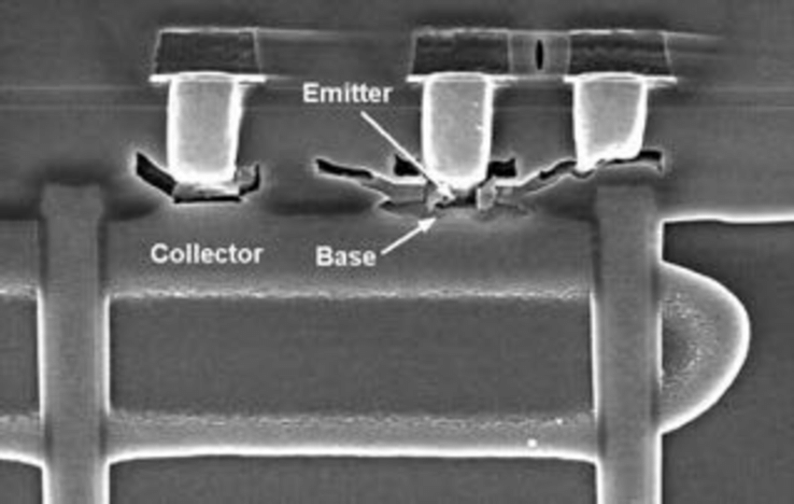
LEGACY VISUAL · SOURCE SLIDE 260
SEM Evidence
READ THE VISUAL
1
Read dimensions from the scale
2
Distinguish surface from cross-section imaging
3
Link the image to the process question
CMOS Process Integration · TGS-2024051248
© 2026 Tertiary Infotech Academy Pte Ltd
93

Slide 94
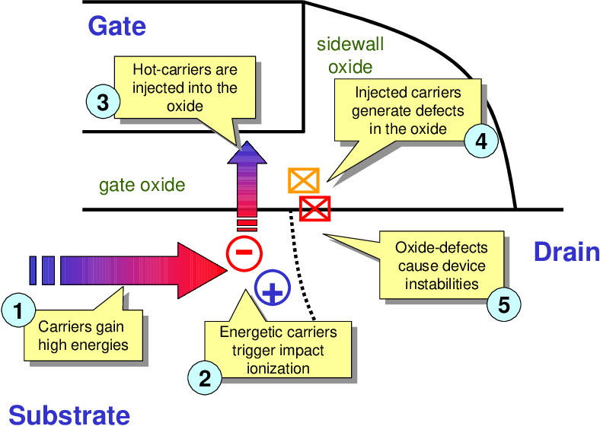
LEGACY VISUAL · SOURCE SLIDE 279
Hot-Carrier Degradation
READ THE VISUAL
1
Locate the high-field drain region
2
Connect trapped charge to parameter shift
3
Identify stress and readout evidence
CMOS Process Integration · TGS-2024051248
© 2026 Tertiary Infotech Academy Pte Ltd
94

Slide 95
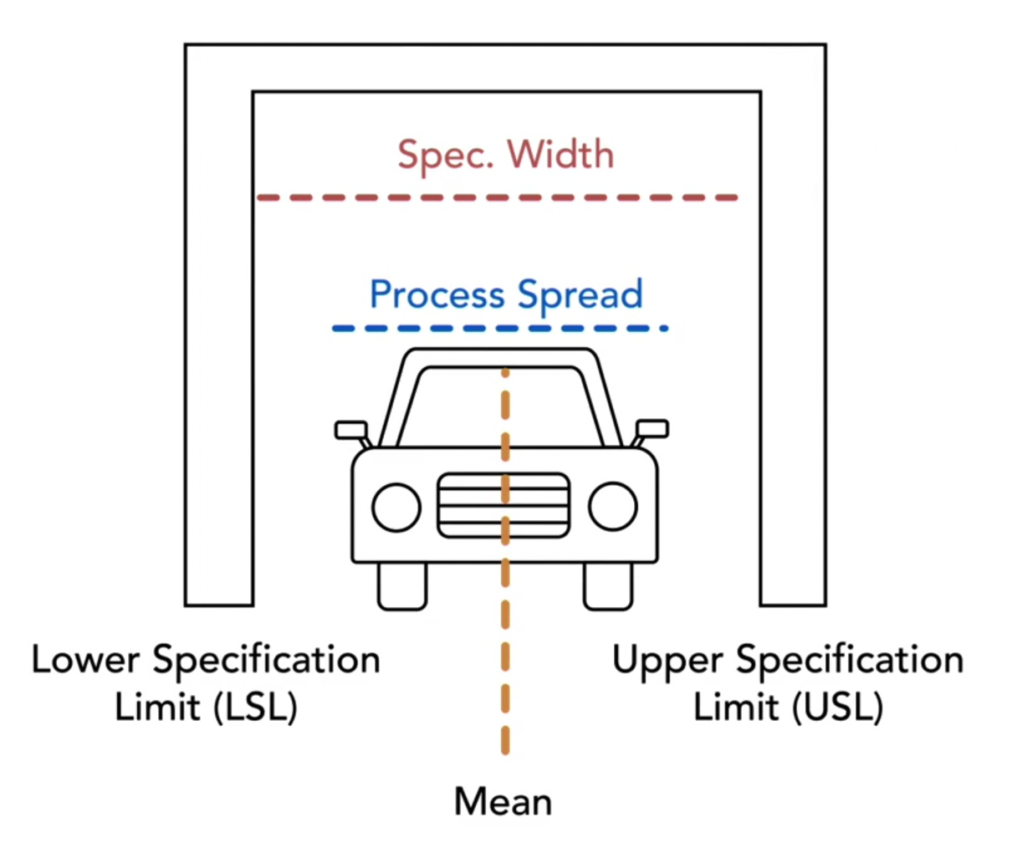
LEGACY VISUAL · SOURCE SLIDE 294
Capability Is Spread plus Centering
READ THE VISUAL
1
Compare distribution with specifications
2
Separate potential from actual capability
3
Do not claim capability before stability
CMOS Process Integration · TGS-2024051248
© 2026 Tertiary Infotech Academy Pte Ltd
95

Slide 96
LEARNING BLOCK 2A · REAL-USE-CASE ACTIVITY
Review an STI Integration Flow
ACTIVITY 5
TechSemicon is introducing shallow trench isolation for an advanced CMOS product. Electrical spread and active-area CD variation appear after integration, and the review board needs a complete process/evidence chain.
YOU'LL PRODUCE
Produce the process-flow and challenge analysis used as the foundation for Practical Performance Task 1.
Full procedure: Learner Guide and individual activity folder
LO2 · A1 / A2 / A4 · 75 minutes
CMOS Process Integration · TGS-2024051248
© 2026 Tertiary Infotech Academy Pte Ltd
96

Slide 97
ACTIVITY 5 · ANALYSE BEFORE DECIDING
Visual Brief and Evidence Lens
1
Which module interaction is most critical?
2
What evidence distinguishes competing causes?
3
Where is the hold/release gate?
4
What follow-up action closes the risk?
CMOS Process Integration · TGS-2024051248
© 2026 Tertiary Infotech Academy Pte Ltd
97

Slide 98
ACTIVITY 5 · VERIFY
Acceptance Review
✓
The eight core STI stages are in the correct order and have a purpose.
✓
At least four implementation challenges are linked to measurements.
✓
The flow explains both scaling benefit and integration risk.
Evidence: analysis output · completed checklist · measurement trail · decision and owner
CMOS Process Integration · TGS-2024051248
© 2026 Tertiary Infotech Academy Pte Ltd
98

Slide 99
LEARNING BLOCK 2A · REAL-USE-CASE ACTIVITY
Analyse Yield and Process Capability
ACTIVITY 6
A gate module has a target CD of 100 nm with specification limits at 90 and 110 nm. The process owner needs Cp/Cpk evidence and a reasoned yield-risk statement before qualification.
YOU'LL PRODUCE
Recreate and improve the legacy ProcessCapability exercise using an auditable Excel workbook with dynamic formulas.
Full procedure: Learner Guide and individual activity folder
LO2 · K2 / A3 / A4 · 75 minutes
CMOS Process Integration · TGS-2024051248
© 2026 Tertiary Infotech Academy Pte Ltd
99

Slide 100
ACTIVITY 6 · ANALYSE BEFORE DECIDING
Visual Brief and Evidence Lens
1
Which module interaction is most critical?
2
What evidence distinguishes competing causes?
3
Where is the hold/release gate?
4
What follow-up action closes the risk?
CMOS Process Integration · TGS-2024051248
© 2026 Tertiary Infotech Academy Pte Ltd
100

Slide 101
ACTIVITY 6 · VERIFY
Acceptance Review
✓
Workbook formulas remain intact and show no Excel errors.
✓
The learner distinguishes Cp from Cpk and links both to process evidence.
✓
The decision includes containment, corrective action and verification.
Evidence: analysis output · completed checklist · measurement trail · decision and owner
CMOS Process Integration · TGS-2024051248
© 2026 Tertiary Infotech Academy Pte Ltd
101

Slide 102
CHECK YOUR UNDERSTANDING
Block 2A Recap
1
Explain
2
Explain
3
Explain
4
Explain
HCI, TDDB and Electromigration
Control Limits versus Specifications
Capability: Cp and Cpk
Evidence-Based Release
CMOS Process Integration · TGS-2024051248
© 2026 Tertiary Infotech Academy Pte Ltd
102

Slide 103
Afternoon Break
10 minutes
CMOS Process Integration · TGS-2024051248
© 2026 Tertiary Infotech Academy Pte Ltd
103

Slide 104
OFFICIAL TOPIC 2 · LEARNING BLOCK 2B
2B
SPC, Packaging and Future Integration
Control excursions, close the feedback loop and evaluate next-generation choices.
CMOS Process Integration · TGS-2024051248
© 2026 Tertiary Infotech Academy Pte Ltd
104

Slide 105
PART 1 · BUILD THE MODEL
Block 2B Roadmap
1
SPC as a Feedback System
2
Select the Chart from the Data
3
Variable Control Charts
4
Attribute Control Charts
SPC as a Feedback System
Select the Chart from the Data
Variable Control Charts
Attribute Control Charts
5
Signals Beyond One Point
6
Excursion Response
Signals Beyond One Point
Excursion Response
CMOS Process Integration · TGS-2024051248
© 2026 Tertiary Infotech Academy Pte Ltd
105

Slide 106
PART 2 · VERIFY THE EVIDENCE
Block 2B Roadmap
1
Packaging Process Flow
2
Wire Bond and Flip Chip
3
2.5D, 3D and Chiplets
4
FinFET
Packaging Process Flow
Wire Bond and Flip Chip
2.5D, 3D and Chiplets
FinFET
5
GAAFET Nanosheets
6
Beyond Today's CMOS
GAAFET Nanosheets
Beyond Today's CMOS
CMOS Process Integration · TGS-2024051248
© 2026 Tertiary Infotech Academy Pte Ltd
106

Slide 107
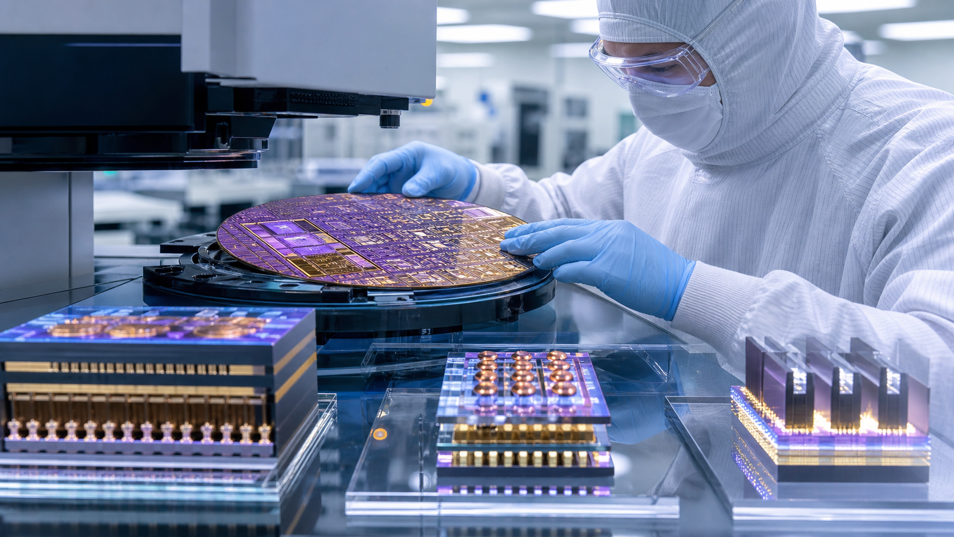
BLOCK 2B · IMAGEGEN VISUAL
SPC, Packaging and Future Integration in Practice
1
What module is creating the feature?
2
Which interaction can move device performance?
3
What measurement makes the decision defensible?
4
Where should feedback or containment occur?
CMOS Process Integration · TGS-2024051248
© 2026 Tertiary Infotech Academy Pte Ltd
107

Slide 108
LEARNING BLOCK 2B · OFFICIAL TOPIC 2
SPC as a Feedback System
1
Sample the process with a rational subgroup
2
Plot performance against behaviour-based limits
3
Detect special-cause signals
4
Contain risk and restore control with evidence
Sample the process with a rational subgroup
Plot performance against behaviour-based limits
Detect special-cause signals
Contain risk and restore control with evidence
CMOS Process Integration · TGS-2024051248
© 2026 Tertiary Infotech Academy Pte Ltd
108

Slide 109
LEARNING BLOCK 2B · OFFICIAL TOPIC 2
Select the Chart from the Data
1
Variable data
2
Attribute data
3
Subgroup size decides Xbar-R versus Xbar-S
4
Opportunity and sample size decide p, np, c or u
measurements such as CD
counts or proportions
Subgroup size decides Xbar-R versus Xbar-S
Opportunity and sample size decide p, np, c or u
CMOS Process Integration · TGS-2024051248
© 2026 Tertiary Infotech Academy Pte Ltd
109

Slide 110
LEARNING BLOCK 2B · OFFICIAL TOPIC 2
Variable Control Charts
WHAT CHANGES
WHAT TO VERIFY
1
Xbar tracks subgroup centre
1
The two charts answer different questions
2
R or S tracks within-subgroup spread
2
A mean chart is incomplete without spread
CMOS Process Integration · TGS-2024051248
© 2026 Tertiary Infotech Academy Pte Ltd
110

Slide 111
LEARNING BLOCK 2B · OFFICIAL TOPIC 2
Attribute Control Charts
1
p chart
2
np chart
3
c chart
4
u chart
proportion defective, variable sample size
defective count, constant sample size
defect count, constant opportunity
defects per unit, variable opportunity
CMOS Process Integration · TGS-2024051248
© 2026 Tertiary Infotech Academy Pte Ltd
111

Slide 112
LEARNING BLOCK 2B · OFFICIAL TOPIC 2
Signals Beyond One Point
1
A point beyond a limit is a strong signal
2
Runs and trends expose non-random change
3
Stratification reveals tool, wafer or time source
4
Rules must be defined before interpretation
A point beyond a limit is a strong signal
Runs and trends expose non-random change
Stratification reveals tool, wafer or time source
Rules must be defined before interpretation
CMOS Process Integration · TGS-2024051248
© 2026 Tertiary Infotech Academy Pte Ltd
112

Slide 113
DECISION SEQUENCE · PROCEDURE IN LEARNER GUIDE
Excursion Response
1
2
3
4
Contain
Stratify
Correct
Verify
Hold material and preserve evidence
Tool, chamber, wafer, product and time
Controlled change with rollback criteria
Stable behaviour and capability
CMOS Process Integration · TGS-2024051248
© 2026 Tertiary Infotech Academy Pte Ltd
113

Slide 114
LEARNING BLOCK 2B · OFFICIAL TOPIC 2
Packaging Process Flow
1
Prepare and thin wafer
2
Separate, inspect and attach die
3
Create electrical interconnect
4
Seal, plate, final-test and burn-in as required
Prepare and thin wafer
Separate, inspect and attach die
Create electrical interconnect
Seal, plate, final-test and burn-in as required
CMOS Process Integration · TGS-2024051248
© 2026 Tertiary Infotech Academy Pte Ltd
114

Slide 115
LEARNING BLOCK 2B · OFFICIAL TOPIC 2
Wire Bond and Flip Chip
WHAT CHANGES
WHAT TO VERIFY
1
Wire bond is flexible but adds loop length
1
Underfill and joint quality manage mechanical risk
2
Flip chip raises I/O density
2
Inspection and test protect assembly yield
CMOS Process Integration · TGS-2024051248
© 2026 Tertiary Infotech Academy Pte Ltd
115

Slide 116
LEARNING BLOCK 2B · OFFICIAL TOPIC 2
2.5D, 3D and Chiplets
1
Interposers connect multiple dies
2
3D stacks use vertical connections
3
Known-good-die and thermal design are inputs
4
Integration control crosses organisations
Interposers connect multiple dies
3D stacks use vertical connections
Known-good-die and thermal design are inputs
Integration control crosses organisations
CMOS Process Integration · TGS-2024051248
© 2026 Tertiary Infotech Academy Pte Ltd
116

Slide 117
LEARNING BLOCK 2B · OFFICIAL TOPIC 2
FinFET
1
A fin raises the channel above substrate
2
Multiple gate surfaces improve control
3
Fin geometry and parasitics affect performance
4
Patterning and variability challenge manufacturing
A fin raises the channel above substrate
Multiple gate surfaces improve control
Fin geometry and parasitics affect performance
Patterning and variability challenge manufacturing
CMOS Process Integration · TGS-2024051248
© 2026 Tertiary Infotech Academy Pte Ltd
117

Slide 118
LEARNING BLOCK 2B · OFFICIAL TOPIC 2
GAAFET Nanosheets
Gate surrounds the channel
Stacked sheets increase effective width
Release, inner spacer and contacts are critical
Gate surrounds the channel
Stacked sheets increase effective width
Release, inner spacer and contacts are critical
CMOS Process Integration · TGS-2024051248
© 2026 Tertiary Infotech Academy Pte Ltd
118

Slide 119
DECISION SEQUENCE · PROCEDURE IN LEARNER GUIDE
Technology Readiness Gate
1
2
3
4
Process
Performance
Reliability
Manufacturing
Capability and module interactions
Device metrics against target
Stress evidence and failure criteria
Yield, test and ownership
CMOS Process Integration · TGS-2024051248
© 2026 Tertiary Infotech Academy Pte Ltd
119

Slide 120
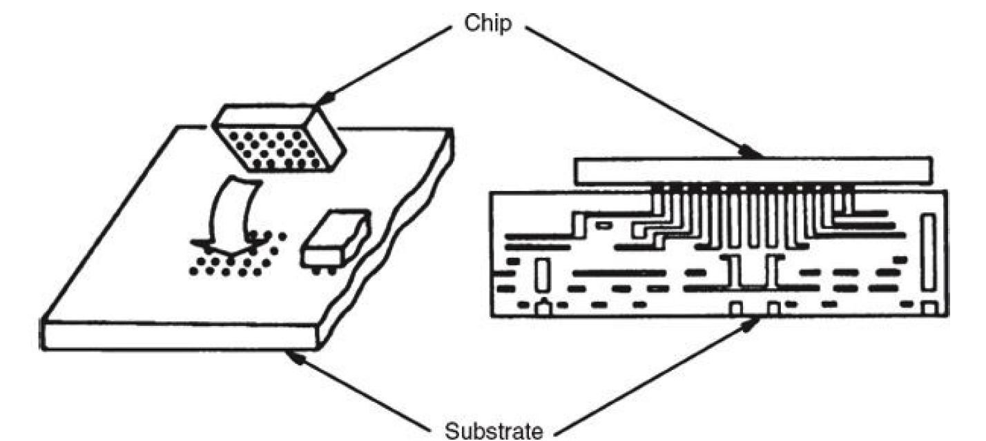
LEGACY VISUAL · SOURCE SLIDE 349
Flip-Chip Interconnect
READ THE VISUAL
1
Trace die-to-substrate connections
2
Locate solder joints and underfill
3
Connect geometry to mechanical risk
CMOS Process Integration · TGS-2024051248
© 2026 Tertiary Infotech Academy Pte Ltd
120

Slide 121
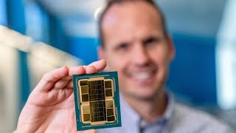
LEGACY VISUAL · SOURCE SLIDE 368
Chiplet Integration
READ THE VISUAL
1
Identify separate functional dies
2
Recognise substrate or interposer
3
Treat known-good-die and test as inputs
CMOS Process Integration · TGS-2024051248
© 2026 Tertiary Infotech Academy Pte Ltd
121

Slide 122
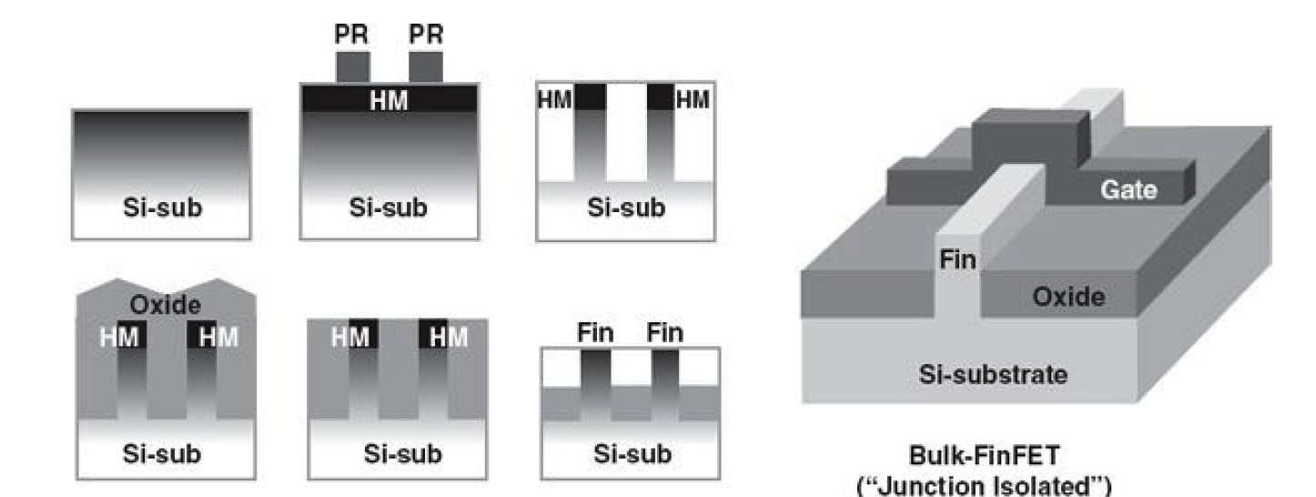
LEGACY VISUAL · SOURCE SLIDE 371
FinFET Geometry
READ THE VISUAL
1
Read gate contact around the fin
2
Connect fin geometry to channel width
3
Identify geometry-sensitive modules
CMOS Process Integration · TGS-2024051248
© 2026 Tertiary Infotech Academy Pte Ltd
122

Slide 123
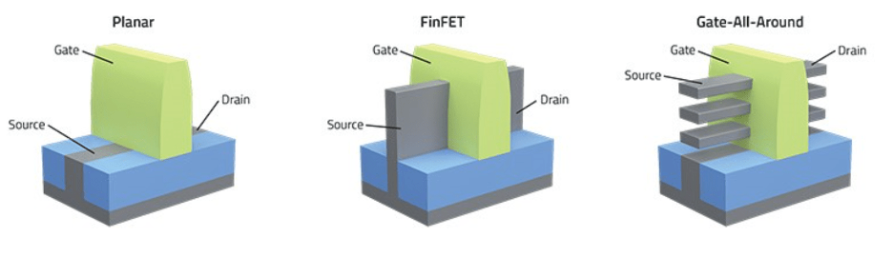
LEGACY VISUAL · SOURCE SLIDE 372
GAAFET Nanosheet Geometry
READ THE VISUAL
1
See the gate surrounding each sheet
2
Compare stacked channel configurations
3
Identify release and spacer risk
CMOS Process Integration · TGS-2024051248
© 2026 Tertiary Infotech Academy Pte Ltd
123

Slide 124
LEARNING BLOCK 2B · REAL-USE-CASE ACTIVITY
Respond to an SPC CD Excursion
ACTIVITY 7
STI active-area CD is drifting across production lots. A point crosses the upper control limit and a seven-point upward run appears before the alarm. The team must contain risk and restore control.
YOU'LL PRODUCE
Recreate the legacy P-chart/SPC exercises and generate the corrective-action chain used in Practical Performance Task 2.
Full procedure: Learner Guide and individual activity folder
LO2 · K2 / A3 / A4 / A5 · 90 minutes
CMOS Process Integration · TGS-2024051248
© 2026 Tertiary Infotech Academy Pte Ltd
124

Slide 125
ACTIVITY 7 · ANALYSE BEFORE DECIDING
Visual Brief and Evidence Lens
1
Which module interaction is most critical?
2
What evidence distinguishes competing causes?
3
Where is the hold/release gate?
4
What follow-up action closes the risk?
CMOS Process Integration · TGS-2024051248
© 2026 Tertiary Infotech Academy Pte Ltd
125

Slide 126
ACTIVITY 7 · VERIFY
Acceptance Review
✓
The response identifies both limit violation and non-random pattern.
✓
Containment precedes root-cause adjustment and protects affected lots.
✓
Corrective action, verification criteria and follow-up owner are explicit.
Evidence: analysis output · completed checklist · measurement trail · decision and owner
CMOS Process Integration · TGS-2024051248
© 2026 Tertiary Infotech Academy Pte Ltd
126

Slide 127
LEARNING BLOCK 2B · REAL-USE-CASE ACTIVITY
Run a Future-Technology Integration Gate
ACTIVITY 8
A product team is deciding whether to adopt chiplet packaging, FinFET or GAAFET for its next platform. Integration readiness must be assessed using process, performance, reliability and packaging evidence.
YOU'LL PRODUCE
Combine the entire course into a structured technology-gate recommendation without treating future devices as isolated marketing concepts.
Full procedure: Learner Guide and individual activity folder
LO2 · K1 / K2 / A2 / A3 / A4 / A5 · 60 minutes
CMOS Process Integration · TGS-2024051248
© 2026 Tertiary Infotech Academy Pte Ltd
127

Slide 128
ACTIVITY 8 · ANALYSE BEFORE DECIDING
Visual Brief and Evidence Lens
1
Which module interaction is most critical?
2
What evidence distinguishes competing causes?
3
Where is the hold/release gate?
4
What follow-up action closes the risk?
CMOS Process Integration · TGS-2024051248
© 2026 Tertiary Infotech Academy Pte Ltd
128

Slide 129
ACTIVITY 8 · VERIFY
Acceptance Review
✓
The recommendation integrates process, device, reliability, yield and packaging evidence.
✓
Every gate has a measurable threshold and an accountable follow-up action.
✓
The conclusion is conditional on evidence rather than technology hype.
Evidence: analysis output · completed checklist · measurement trail · decision and owner
CMOS Process Integration · TGS-2024051248
© 2026 Tertiary Infotech Academy Pte Ltd
129

Slide 130
CHECK YOUR UNDERSTANDING
Block 2B Recap
1
Explain
2
Explain
3
Explain
4
Explain
2.5D, 3D and Chiplets
FinFET
GAAFET Nanosheets
Beyond Today's CMOS
CMOS Process Integration · TGS-2024051248
© 2026 Tertiary Infotech Academy Pte Ltd
130

Slide 131
WRAP-UP
Integrated CMOS Decision Workflow
Process · interaction · evidence · performance · action
CMOS Process Integration · TGS-2024051248
© 2026 Tertiary Infotech Academy Pte Ltd
131

Slide 132
CAPSTONE
The Complete Workflow
1
2
3
4
5
▶
▶
▶
▶
Identify technology flow
Map module interactions
Select performance evidence
Verify against requirements
Contain and follow up
CMOS Process Integration · TGS-2024051248
© 2026 Tertiary Infotech Academy Pte Ltd
132

Slide 133
LEARNING OUTCOMES
What You Can Now Do
1
LO1
2
LO2
3
Explain how process interactions propagate
4
Select physical, electrical and statistical evidence
Identify process flows and modules for specific CMOS technologies in manufacturing.
Determine CMOS device performance and verify process integration in accordance with product specifications.
Explain how process interactions propagate
Select physical, electrical and statistical evidence
5
Define a hold/release and follow-up decision
Define a hold/release and follow-up decision
CMOS Process Integration · TGS-2024051248
© 2026 Tertiary Infotech Academy Pte Ltd
133

Slide 134
QUALITY GATE
Professional Integration Review
Process and evidence
Decision and ownership
1
Is the process sequence complete?
1
Does performance meet product requirements?
2
Which interaction creates the risk?
2
Is the process stable and capable?
3
What incoming and outgoing evidence exists?
3
Is reliability evidence sufficient?
4
Are limits and uncertainty explicit?
4
Who owns the next action and by when?
CMOS Process Integration · TGS-2024051248
© 2026 Tertiary Infotech Academy Pte Ltd
134

Slide 135
SOURCE TRACEABILITY
Source and Evidence Register
1
Legacy v7 trainer deck retained as the content and visual coverage floor
2
Original graphics use aspect-ratio-safe contain placement
3
New Imagegen visuals are recorded in the source register
4
Detailed procedures remain in the Learner Guide and activity folders
CMOS Process Integration · TGS-2024051248
© 2026 Tertiary Infotech Academy Pte Ltd
135

Slide 136
LMS/TMS
Courseware and Assessment on the LMS
1
Download current learner materials
2
Complete the WA then PP
3
Upload completed answers
4
Contact enquiry@tertiaryinfotech.com for support
CMOS Process Integration · TGS-2024051248
© 2026 Tertiary Infotech Academy Pte Ltd
136

Slide 137
ASSESSMENT
Final Assessment
WA-SAQ
PP
1
Written Assessment
1
Practical Performance
2
2 open-ended questions
2
2 integrated tasks
3
K1-K2
3
A1-A5
4
60 minutes
4
60 minutes
CMOS Process Integration · TGS-2024051248
© 2026 Tertiary Infotech Academy Pte Ltd
137

Slide 138
ON ASSESSMENT DAY
Assessment Flow
1
2
3
4
5
▶
▶
▶
▶
TRAQOM on LMS
Assessment digital attendance
Sit WA then PP
Submit on LMS
Sign summary record
CMOS Process Integration · TGS-2024051248
© 2026 Tertiary Infotech Academy Pte Ltd
138

Slide 139
TRAQOM · SSG
Digital Attendance (Mandatory)
1
Complete Assessment digital attendance before starting
2
Use the SSG QR code shown by the trainer
3
Submit attendance successfully
4
Ask the trainer if confirmation is not visible
CMOS Process Integration · TGS-2024051248
© 2026 Tertiary Infotech Academy Pte Ltd
139

Slide 140
CMOS PROCESS INTEGRATION
Thank You
Integrate the flow, follow the evidence and close every risk with an accountable action.
CMOS Process Integration · TGS-2024051248
© 2026 Tertiary Infotech Academy Pte Ltd
140

